Slide 1
Spring Core

Slide 2
Spring Core
Spring framework
Dependency injection
Spring container
Application context
Beans
Spring configuration
Spring wiring
Filtering beans
Three layer web architecture
Maven basics

Slide 3
Spring Framework
Spring
open source framework
was created to address the complexity of enterprise application development
simplifies Java development by employing four key strategies:
lightweight and minimally invasive development with plain old Java objects (POJOs)
loose coupling through dependency injection and interface orientation
declarative programming through aspects
boilerplate reduction through aspects and templates

Slide 4
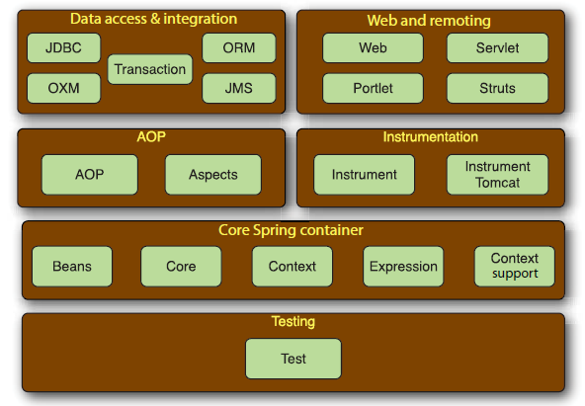
Spring Framework
The Spring Framework is made up of six well-defined modules:

Slide 5
Dependency Injection
In software engineering, dependency injection is a software design pattern that implements inversion of control for resolving dependencies.
Traditionally, each object is responsible for obtaining its own references to the objects it collaborates with (its dependencies). This can lead to highly coupled and hard-to-test code.
With DI, objects are given their dependencies at creation time by some third party that coordinates each object in the system. Objects aren’t expected to create or obtain their dependencies.
Notes:
In software engineering, inversion of control (IoC) is a design principle in which custom-written portions of a computer program receive the flow of control from a generic framework. A software architecture with this design inverts control as compared to traditionalprocedural programming: in traditional programming, the custom code that expresses the purpose of the program calls into reusable libraries to take care of generic tasks, but with inversion of control, it is the framework that calls into the custom, or task-specific, code.

Slide 6
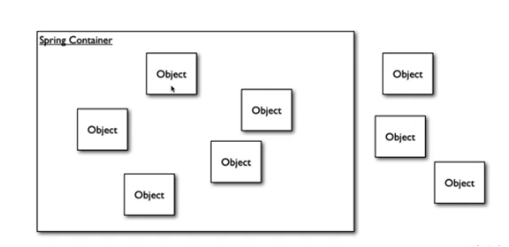
Spring container
In a Spring-based application, your application objects live in the Spring container.
The container is at the core of the Spring Framework. Spring’s container uses DI to
manage the components that make up an application.
Objects are managed by the container: instantiation, lifecycle and destruction
This includes creating associations between collaborating components.
As such, these objects are cleaner and easier to understand, they support reuse, and they’re easy to unit test
There can be objects outside the container, but they will not be managed by the container

Slide 7
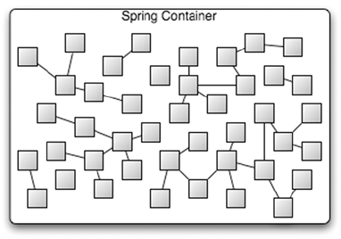
Spring container
There’s no single Spring container. Spring comes with several container implementations that can be categorized into two distinct types:
Bean factories
Application contexts - build on the notion of a bean factory by providing application-framework services, such as the ability to resolve textual messages from a properties file and the ability to publish application events to interested event listeners

Slide 8
Application context
Application Context
In a Spring application, an application context loads bean definitions and wires them together
It is fully responsible for the creation and wiring of the objects that make up the application
Spring comes with several implementations of its application context, each primarily differing only in how they load their configuration
Spring provides several implementation of the Application Context:
AnnotationConfigApplicationContext —Loads a Spring application context from one or more Java-based configuration classes
AnnotationConfigWebApplicationContext —Loads a Spring web application context from one or more Java-based configuration classes
ClassPathXmlApplicationContext - Loads a context definition from one or more XML files located in the classpath, treating context-definition files as classpath resources
FileSystemXmlApplicationContext —Loads a context definition from one or more XML files in the filesystem
XmlWebApplicationContext —Loads context definitions from one or more XML files contained in a web application

Slide 9
Beans
Definition
The bean definition contains the information called configuration metadata which is needed for the container to know the followings:
How to create a bean
Bean's lifecycle details
Bean's dependencies
All the above configuration metadata translates into a set of the following properties that make up each bean definition (xml configuration):
class - is mandatory and specifies the bean class to be used to create the bean
name or id - specifies the bean identifier uniquely
scope - specifies the scope of the objects created from a particular bean definition
constructor-arg - used to inject the dependencies
properties - used to inject the dependencies
autowiring mode - used to inject the dependencies
lazy-initialization mode - tells the IoC container to create a bean instance when it is first requested, rather than at startup
initialization method - a callback to be called just after all necessary properties on the bean have been set by the container
destruction method - a callback to be used when the container containing the bean is destroyed

Slide 10
Beans
Beans – scopes
In Spring, bean scope is used to decide which type of bean instance should be returned from Spring container back to the caller
Singleton – only one instance of bean per spring container ( Default scope)
Prototype – a new instance every time a bean is requested
Request – a single bean instance per HTTP request
Session – single bean instance per HTTP session
Global-session – single bean instance per global HTTP session

Slide 11
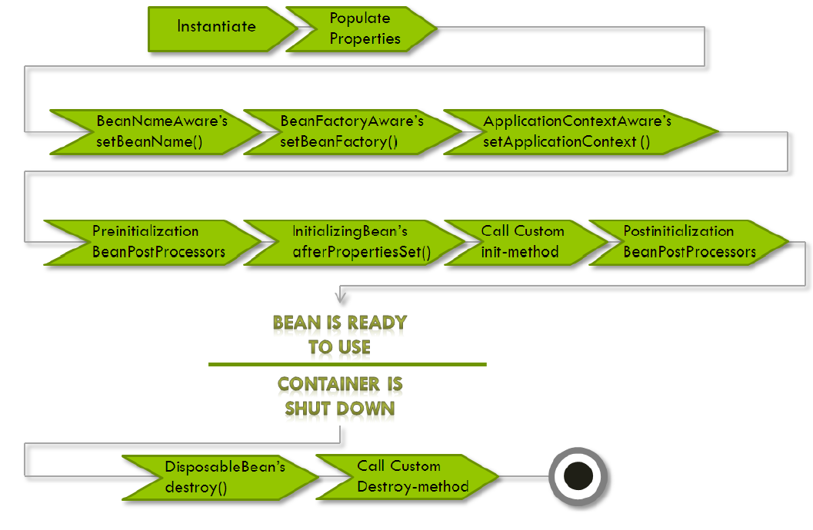
Beans
Beans lifecycle - A bean goes through several steps between creation and destruction in the Spring
container. Each step is an opportunity to customize how the bean is managed in Spring.

Slide 12
Beans
Beans lifecycle
Initialization callbacks
InitializingBean interface - allows a bean to perform initialization work after all necessary properties on the bean have been set by the container
public class AnotherExampleBean implements InitializingBean {
public void afterPropertiesSet() { // do some initialization work }
}
Recommended to use @PostConstruct method annotation instead
Destruction callbacks
DisposableBean interface - allows a bean to get a callback when the container containing it is destroyed
public class AnotherExampleBean implements DisposableBean {
public void destroy() { // do some destruction work (like releasing pooled connections)}
}
Recommended to use @PreDestroy method annotation instead

Slide 13
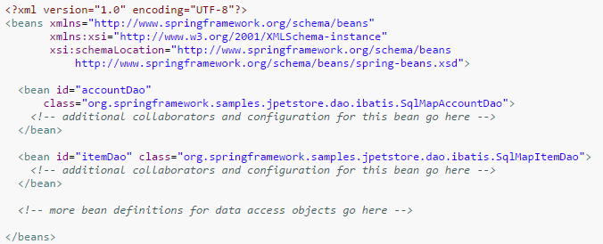
Spring configuration
XML-based configuration
Annotation-based configuration
@Required, @Autowired, @Qualifier, @Component, @Controller, @Service, @Scope, @Resource
Java-based configuration
@Configuration, @Bean

Slide 14
Spring configuration
XML-based configuration - Setter
<bean id="exampleBean" class=“com.examples.ExampleBean">
<!-- setter injection using the nested <ref/> element -->
<property name="beanOne"><ref bean="anotherExampleBean"/></property>
<!-- setter injection using the neater 'ref' attribute -->
<property name="beanTwo" ref="yetAnotherBean"/>
<property name="integerProperty" value="1"/>
</bean>
<bean id="anotherExampleBean" class=“com.examples.AnotherBean"/>
<bean id="yetAnotherBean" class=“com.examples.YetAnotherBean"/>
public class ExampleBean {
private AnotherBean beanOne;
private YetAnotherBean beanTwo;
private int i;
public void setBeanOne( AnotherBean beanOne) {this.beanOne = beanOne;}
public void setBeanTwo( YetAnotherBean beanTwo) {this.beanTwo = beanTwo;}
public void setIntegerProperty(int i) {
this.i = i;
}
}

Slide 15
Spring configuration
XML-based configuration - Constructor
<bean id="exampleBean" class="examples.ExampleBean">
<!-- constructor injection using the nested <ref/> element -->
<constructor-arg>
<ref bean="anotherExampleBean"/>
</constructor-arg>
<!-- constructor injection using the neater 'ref' attribute -->
<constructor-arg ref="yetAnotherBean"/>
<constructor-arg type="int" value="1"/>
</bean>
<bean id="anotherExampleBean" class="examples.AnotherBean"/>
<bean id="yetAnotherBean" class="examples.YetAnotherBean"/>
public class ExampleBean {
private AnotherBean beanOne;
private YetAnotherBean beanTwo;
private int i;
public ExampleBean(
AnotherBean anotherBean, YetAnotherBean yetAnotherBean, int i) {
this.beanOne = anotherBean; this.beanTwo = yetAnotherBean; this.i = i;
}
}

Slide 16
Spring configuration
XML-based configuration – Static factory method
<bean id="exampleBean" class="examples.ExampleBean“ factory-method="createInstance">
<constructor-arg ref="anotherExampleBean"/>
<constructor-arg ref="yetAnotherBean"/>
<constructor-arg value="1"/>
</bean>
public class ExampleBean {
// a private constructor
private ExampleBean(...) {}
// a static factory method; the arguments to this method can be
// considered the dependencies of the bean that is returned,
// regardless of how those arguments are actually used.
public static ExampleBean createInstance (
AnotherBean anotherBean, YetAnotherBean yetAnotherBean, int i) {
ExampleBean eb = new ExampleBean (...);
// some other operations...
return eb;
}
}

Slide 17
Spring configuration
Annotation-based configuration
Instead of using XML to describe a bean wiring, you can move the bean configuration into the component class itself by using annotations on the relevant class, method, or field declaration
Annotation injection is performed before XML injection, thus the latter configuration will override the former for properties wired through both approaches.
Annotation wiring is not turned on in the Spring container by default
This can be done by adding <context:annotation-config/> element from Spring’s context configuration namespace
<context:component-scan/> can also do what <context:annotation-config/> does but <context:component-scan/> also scans packages to find and register beans within the application context
@Required
The @Required annotation applies to bean property setter methods.
Indicates that the affected bean property must be populated at configuration time
The container throws an exception if the affected bean property has not been populated

Slide 18
Spring configuration
Annotation-based configuration
@Autowired
The @Autowired annotation can apply to bean property setter methods, non-setter methods, constructor and properties.
@Qualifier
The @Qualifier annotation along with @Autowired can be used to remove the confusion by specifiying which exact bean will be wired.
SR-250 Annotations
Spring supports JSR-250 based annotations which include @Resource, @PostConstruct and @PreDestroy annotations.
@Component
is a general-purpose stereotype annotation indicating that the class is a Spring component
@Repository, @Service and @Controller
Are specializations of @Component for more specific use cases ( data repository, service and a MVC controller)

Slide 19
Spring configuration
Annotation-based configuration – Post construct and Pre destroy
public class CachingMovieLister {
@PostConstruct
public void populateMovieCache() {// populates the movie cache upon initialization...}
@PreDestroy
public void clearMovieCache() { // clears the movie cache upon destruction...}
}
Annotation based configuration - @Scope
@Scope(value = BeanDefinition.SCOPE_PROTOTYPE)
@Component
public class MovieFinderImpl implements MovieFinder {
// ...
}

Slide 20
Spring configuration
Java based configuration
Annotating a class with the @Configuration indicates that the class can be used by the Spring IoC container as a source of bean definitions.
The @Bean annotation tells Spring that a method annotated with @Bean will return an object that should be registered as a bean in the Spring application context.
Basic example:
@Configuration
public class HelloWorldConfig {
@Bean
public HelloWorld helloWorld(){
return new HelloWorld();
}
}
Equivalent to:
<beans>
<bean id="helloWorld" class="com.tutorialspoint.HelloWorld" />
</beans>

Slide 21
Spring configuration
Java based configuration – Accessing the application context - ApplicationContextAware
public class CommandManager implements ApplicationContextAware {
private ApplicationContext applicationContext;
public Object process(Map commandState) {
Command command = getCommand();
command.setState(commandState);
return command.execute();
}
protected Command getCommand() {
return this.applicationContext.getBean(Command.class);
}
public void setApplicationContext(ApplicationContext applicationContext) throws BeansException {
this.applicationContext = applicationContext;
}
}

Slide 22
Spring wiring
Automatic wiring beans
@Component public class Foo{ @Autowired private Bar pub; private Baz baz; @Autowired public Foo(Baz baz){ this.baz = baz; } }
Component Scanning - Spring automatically discovers beans to be created in the application context
Autowiring - Spring automatically satisfies bean dependencies

Slide 23
Spring wiring
Enabling scanning
<?xml version="1.0" encoding="UTF-8"?> <beans xmlns="http://www.springframework.org/schema/beans" xmlns:context="http://www.springframework.org/schema/context" xmlns:xsi="http://www.w3.org/2001/XMLSchema-instance" xsi:schemaLocation="http://www.springframework.org/schema/beans http://www.springframework.org/schema/beans/spring-beans.xsd http://www.springframework.org/schema/context http://www.springframework.org/schema/context/spring-context.xsd"> <context:component-scan base-package="soundsystem" /> </beans>
@Configuration @ComponentScan(basePackages = "org.package") public class AppConfig{ }

Slide 24
Filtering beans
It is more than once wanted to ignore certain beans in certain situations. Spring can help you with that as well
Profiles
Conditional Beans

Slide 25
Filtering beans - Profiles
@Configuration @Profile("prod") public class ProductionProfileConfig { @Bean public DataSource dataSource() { ….
} }
@RunWith(SpringJUnit4ClassRunner.class) @ContextConfiguration(classes={PersistenceTestConfig.class}) @ActiveProfiles("dev") public class PersistenceTest { ... }
You can configure beans to be created only on specific Spring profiles and make your life a lot easier.

Slide 26
Filtering beans - Conditional beans
@Bean @Conditional(MagicExistsCondition.class) public MagicBean magicBean() { return new MagicBean(); } public interface Condition { boolean matches(ConditionContext ctxt, AnnotatedTypeMetadata metadata); }
As you can see, @Conditional is given a Class that specifies the condition—in this case, MagicExistsCondition. @Conditional comes paired with a Condition interface:

Slide 27
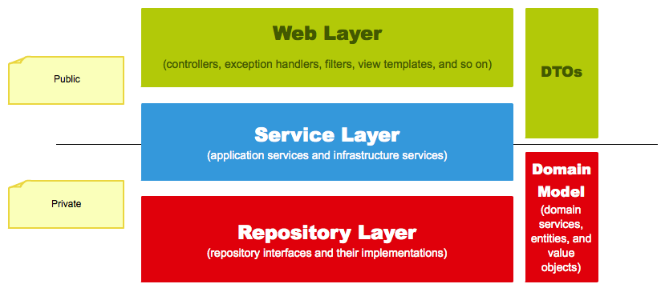
Three layer web architecture

Slide 28
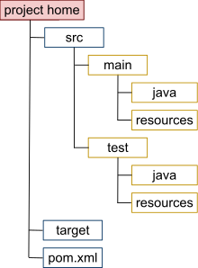
Maven basics
Maven
Build automation tool
Maven - means "accumulator of knowledge" in Yiddish
Dependency management
Plugins (clean – attempts to clean directories generated
at build time)
IDE integration
Life cycle
Project object model
Java project directory structure

Slide 29
Maven basics
Maven lifecycle
validate
generate-sources
process-sources
generate-resources
process-resources
compile
process-test-sources
process-test-resources
test-compile
test
package
install
deploy
Usage: mvn install

Slide 30
Maven basics
Example of pom.xml
<project>
<modelVersion>4.0.0</modelVersion>
<!-- project coordinates, i.e. a group of values which uniquely identify this project -->
<groupId> com.mycompany.app</groupId>
<artifactId> my-app</artifactId>
<version> 1.0</version>
<dependencies>
<dependency>
<!-- coordinates of the required library -->
<groupId> junit</groupId>
<artifactId> junit</artifactId>
<version> 3.8.1</version>
<!-- this dependency is only used for running and compiling tests -->
<scope> test</scope>
</dependency>
</dependencies>
</project>

Slide 31
Exercises
1. Create a POJO class User (id, firstname, lastname, age)
2. Create a service that saves, retrieves a user or all of them. This service should have a dependency on a user repository that interacts with the database (not really for now).
3. The repository should be an implementation of an interface. In the implementation the content of these methods should be only a message printed to the console. A new instance should be returned every time (prototype).
4. The service should have more implementations of an interface demonstrating various ways of injecting the repository dependency in the service:
- Implementing ApplicationContextAware and getting the dependency through the ApplicationContext
- with @Autowired on field, on constructor
And declaring the service:
- declaring the service using @Component
- with the @Bean annotation on a method inside a @Configuration annotated class
- using xml configuration - setter and constructor
5. Inject the service in a controller ( no need to have an interface here) and switch the implementations with @Qualifer annotation to test them
6. Use @PostConstruct method annotation

Slide 32
Questions?

Slide 33


Thank you!
Aroșoaie Andrei
Developer
arosoaie.andrei@endava.com
en_aarosoaie

